Slide 1
Project Demo
Locator/ID Separation Protocol
Traditional and SDN Approach
Ragavi Swarnalatha Raman
Srikanth Gopalakrishnan
Aparajita Bagchi

Slide 2
The protocol
Internet uses IP addresses to depict a device’s identity and location in the network.
The increase in the internet’s default free zone also leads to the increase in the routing table entries of the core network.
Device mobility causes them to be connected to the nearest network, resulting in TCP connection losses.
LISP separates IP addresses into routable and private addresses (RLOCs and EIDs respectively).
Network layer protocol based on concept of dynamic encap and decap of a packet header.
LISP compatible routers (Ingress and EgressTunnel routers) need to be deployed.
Map Server/Map Resolver maintains EID to RLOC mappings.

Slide 3
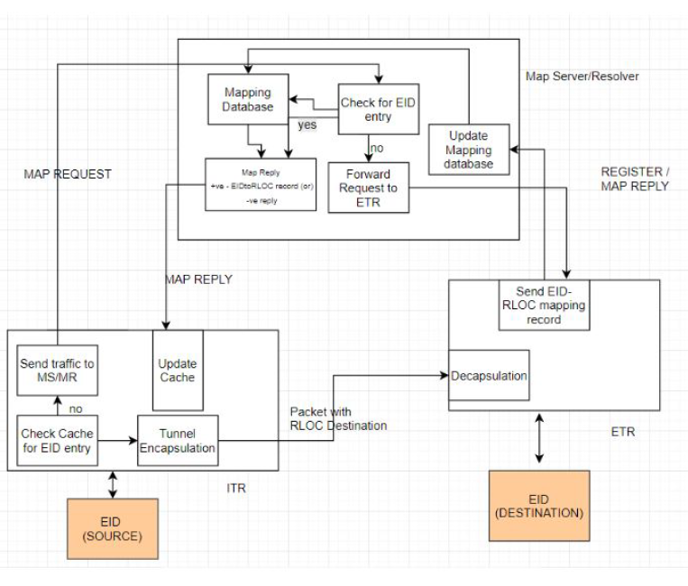
Traditional Approach - Flow Diagram

Slide 4
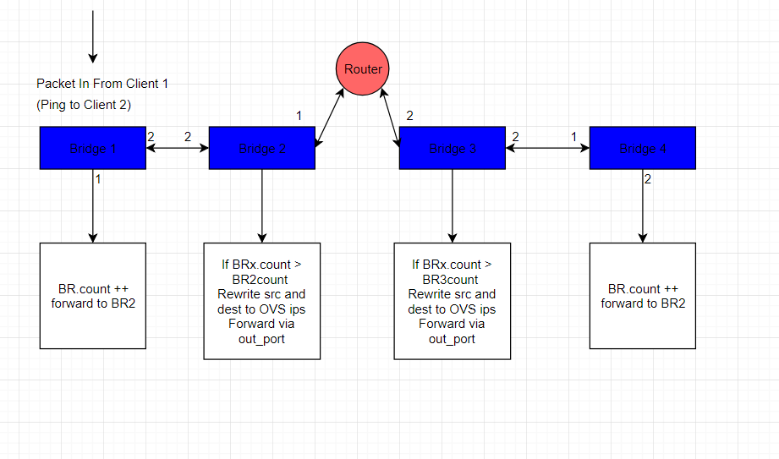
SDN Flow Diagram
ICMP Handling :

Slide 5
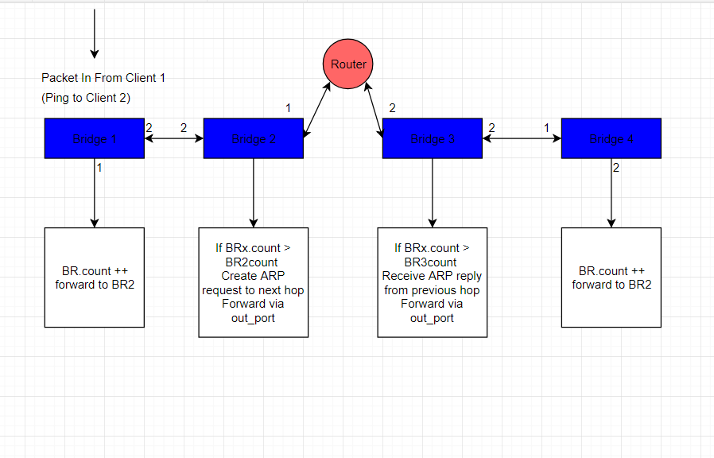
SDN Flow Diagram
ARP Handler:

Slide 6
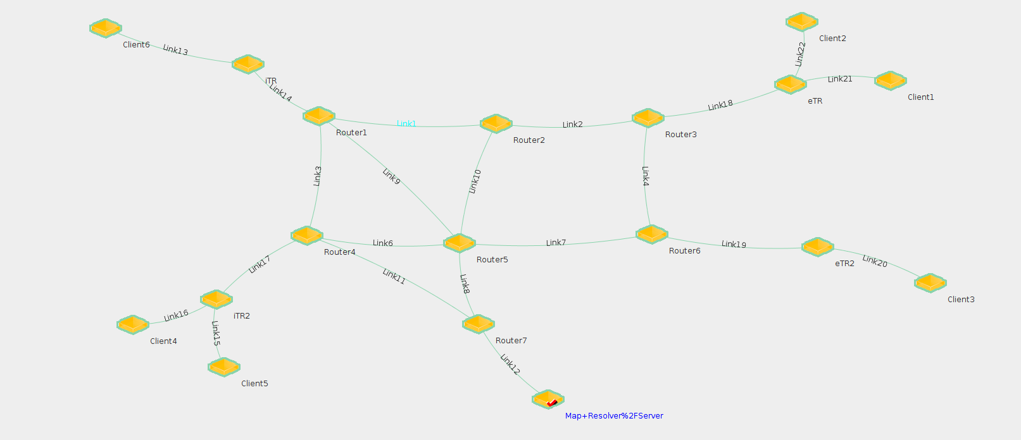
Topology
TRADITIONAL METHOD

Slide 7
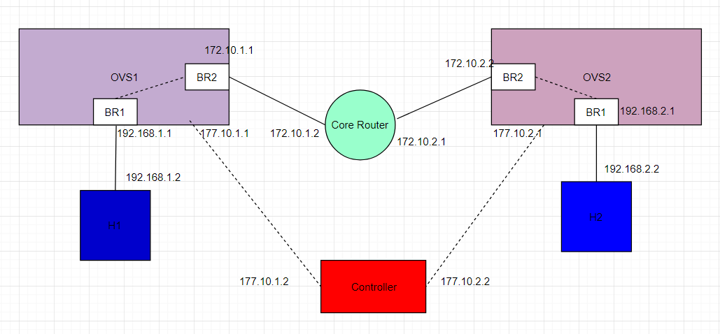
SDN Topology

Slide 8
Demo Plan 1- Turning the MS/MR off - ping from one EID to at least one EID in each xTR
Traditional Approach | SDN Approach
Condition: Set MS/MR down Expected Observation: No map-request/reply between xTRs and MS/MR Ping between EIDs expected to fail EIDs does not identify Public Network and vice versa Tshark captures at xTR in and out interfaces to observe encap/decap | Condition: Northbound interface to MS/MR application is set down Expected Observation: No Packet In messages from OVS to Controller EIDs does not identify Public Network and vice versa Tshark captures at OVS switch interfaces

Slide 9
Demo Plan 2- Sending ICMP packets from one EID to another
Traditional Approach | SDN Approach
Condition: Map Server/Map Resolver and tunnel routers are in running state. Expected Observation: Map Register, Map Request from ITR and Map Reply from Resolver to ITR is observed LISP tunnelling according to EID-RLOC mapping occurs Tshark captures at xTR in and out interfaces to observe encap/decap | Condition: Map Server/Resolver application with manual EID-RLOC entries in SDN controller and OVS switches are in running state Expected Observation: Switch registration and Packet-In request from source OVS to MS/MR application ARP Handling and ICMP Handling at the Controller Source and Destination EIDs changed to OVS public IPs. ARP Handler at each hop Tshark captures at OVS switch interfaces to show changed IPs

Slide 10
Demo Plan 3-Client Mobility by changing EID
Traditional Approach
Condition: Map Server/Map Resolver and tunnel routers are in running state EID moved to another LISP site (attached to another ETR) Expected Observation: New ETR registers new EID-RLOC mapping Map Request from ITR and updated Map Reply from Resolver to ITR is observed LISP tunnelling according to EID-RLOC mapping occurs Tshark captures at xTR in and out interfaces to observe encap/decap

